Slide 1
TRILIFT SMART AUTONOMOUS SHOPPING SYSTEM
CARRY MATE

Slide 2
PRODUCT OVERVIEW
3 Independent Lift Compartments
Auto-Follow via Bluetooth Wristband
Obstacle Detection System
Retrofit Smart Billing Module
Auto Charging + Emergency Battery
Heavy-Duty Long-Life Structure

Slide 3
COMPARTMENT DESIGN
Total Capacity: 70–80 Liters
1️⃣ Bottom Compartment (Cold Storage)
• 15L Capacity
• Peltier Cooling (2–8°C)
• Low-mass items

Slide 4
COMPARTMENT DESIGN
Total Capacity: 70–80 Liters
2️⃣ Middle Compartment (Vegetables/Fruits)
• 25L Capacity
• Ventilated Design
• Shock-absorbing base

Slide 5
COMPARTMENT DESIGN
Total Capacity: 70–80 Liters
3️⃣ Top Compartment (General Items)
• 30L Capacity
• Reinforced ABS body

Slide 6
LIFT MECHANISM (EACH COMPARTMENT)
• Individual Linear Actuator System
• Lift Stroke: 30–40 cm
• Max Lift per Compartment: 20 kg
• Side-mounted Push Button Control
• Gear Motor + Lead Screw Drive
• Load Sensor Feedback
Power: 24V DC

Slide 7
AUTO FOLLOW TECHNOLOGY
• Bluetooth Low Energy (BLE 5.0)
• Smart Wristband Pairing
• Adjustable Distance: 0.5m – 2m
• PID Motor Speed Control
• Real-time Motion Tracking
Response Time: < 250 ms

Slide 8
OBSTACLE DETECTION SYSTEM
• 360° Ultrasonic Sensors
• Infrared Proximity Sensors
• Front Depth Camera (Optional AI Vision)
• Speed Reduction Mode
• Auto Stop Function
Max Speed: 4–5 km/h

Slide 9
MOBILITY SYSTEM
• Dual BLDC Hub Motors
• Motor Driver Controller
• Omni-directional PU Wheels
• Anti-Tip Wide Base Design
• Suspension Support
Turning Radius: < 60 cm

Slide 10
RETROFIT SMART MODULE
Integrated Panel Includes:
• 7-inch Display Pad
• QR Code Scanner
• RFID Reader
• Load Cell (Weight Sensor)
• Billing Thermal Roll Printer
• NFC / Card Swiper
Processor: ARM Cortex Microcontroller

Slide 11
WEIGHT LIFTING HOOK SYSTEM
• Side Retractable Hook
• Max Load: 10 kg
• Foldable Design
• Steel Reinforced Support
• Suitable for Carry Bags

Slide 12
POWER SYSTEM
Battery Type: Lithium-ion
Voltage: 24V
Capacity: 25Ah
Operating Time: 7–8 Hours
Charging Time: 2–3 Hours
Battery Management System (BMS) Integrated

Slide 13
SMART POWER MANAGEMENT
• Battery Level Monitoring
• Signal Alert to Wristband (<20%)
• Auto Dock Navigation Mode
• Emergency Backup Battery (10% Reserve)
• Overcharge & Short Circuit Protection

Slide 14
STRUCTURAL MATERIALS
• Frame: Aluminium Alloy 6061
• Body: ABS + Polycarbonate
• Lift Mechanism: Stainless Steel
• Wheels: Polyurethane
• Internal Support: Mild Steel Reinforced
Product Weight (Without Load): 22–25 kg

Slide 15
SYSTEM BLOCK DIAGRAM (EXPLAIN VERBALLY)
Wristband → BLE Module → Microcontroller
Microcontroller → Motor Driver → BLDC Motors
Sensors → Controller → Motion Control
Load Sensor → Lift Actuator
Battery → BMS → Power Distribution

Slide 16
SAFETY FEATURES
• Emergency Stop Button
• Anti-Collision Mode
• Auto Brake
• Overload Protection
• Thermal Protection (Cooling Zone)

Slide 17
INNOVATION POINTS
• 3 Independent Lift Compartments
• Integrated Cooling + Lift System
• Smart Retrofit Billing
• Auto Charging Return System
• Adjustable Distance Follow Mode
• Multi-Function Retail Integration

Slide 18
ESTIMATED PROTOTYPE COST
Motors: ₹10,000
Lift Actuators: ₹12,000
Sensors: ₹6,000
Battery: ₹8,000
Smart Module: ₹15,000
Frame & Fabrication: ₹15,000
Total: ₹60,000 – ₹70,000 (Prototype)
Mass Production ↓ 30–40%

Slide 19
TARGET USERS
• Elderly
• Women
• Families
• Smart Retail Stores
• Hypermarkets

Slide 20
CONCLUSION
TriLift System =
Autonomous Mobility + Smart Billing + Lift Assist + Cooling Integration
Advanced Retail Automation Solution.

Slide 21


Slide 22


Slide 23


Slide 24


Slide 26


Slide 27


Slide 28


Slide 29


Slide 31



Slide 32


Slide 33


Slide 34


Slide 35

CARRY MATE

Slide 36

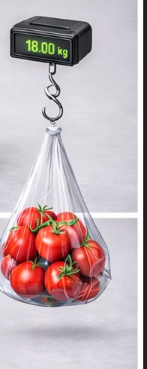
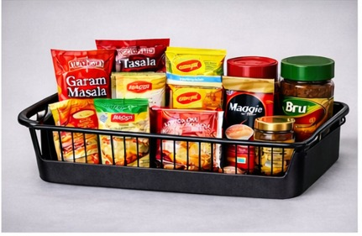
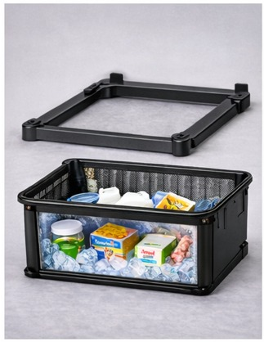

Slide 37
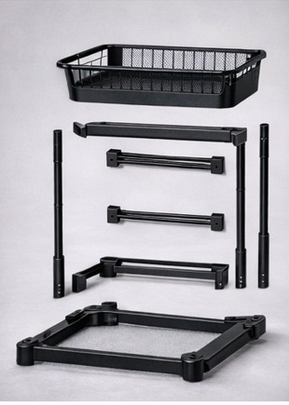
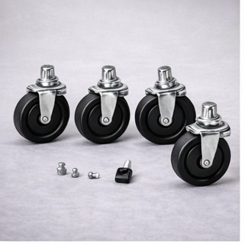

Slide 38
